Slide 1

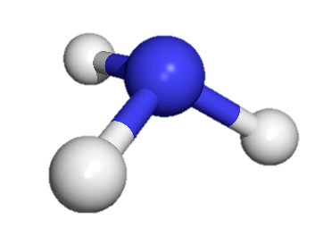



H
N
H
H
Experimental investigation of carbon membrane for NH₃ separation
I. Gargiulo¹, D.A. Pacheco Tanaka², M. A. Llosa Tanco², F. Gallucci¹
Sustainable Process Engineering – Chemical Engineering and Chemistry – Eindhoven University of Technology
TECNALIA, Energy and Environment Division, Mikeletegi Pasealekua 2, 20009 San Sebastian-Donostia, Spain
IX Symposium on Hydrogen, Fuel cells and Advanced Batteries, June 30-July 03, 2024, Milazzo (Italy)

Slide 2










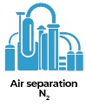




H
N
NH₃ as long-term hydrogen storage
H
H
Ammonia transport
and storage
Ammonia direct
utilization
Renewable
energy
NH₃
Hydrogen
utilization
Ammonia
synthesis
N₂
H₂
Ammonia
decomposition
IX Symposium on Hydrogen, Fuel cells and Advanced Batteries, June 30-July 03, 2024, Milazzo (Italy)
2

Slide 3
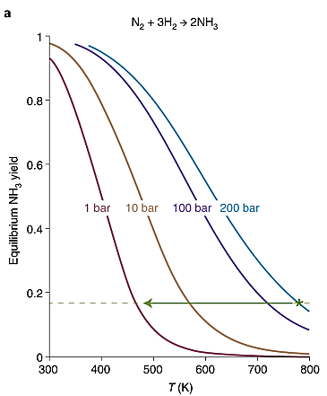
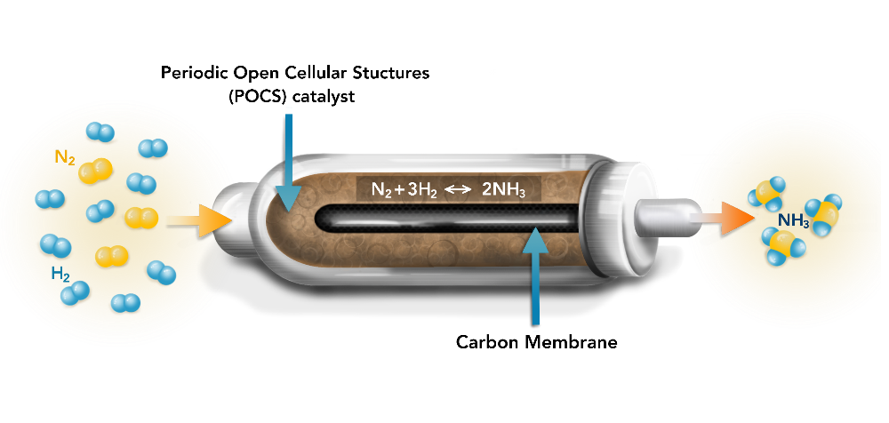




H
N
AMBHER target
H
H
$$N_{2}+3H_{2} ↔{ 2NH}_{3}$$
$${(∆H}_{298K})=−90 kJ/mol$$
Catalytic membrane reactor
for in-situ removal of NH₃
Shifting the equilibrium towards products
(Le Chatelier’s principle)
Shifting the thermodynamic equilibrium
Effective heat management
Energy efficiency
Process intensification
Target conditions:
T=250-300 °C
P=20 bar
Process conditions:
T=400-500 °C
P=100-200 bar
IX Symposium on Hydrogen, Fuel cells and Advanced Batteries, June 30-July 03, 2024, Milazzo (Italy)
3

Slide 4
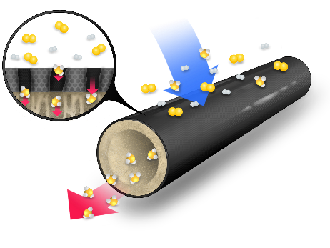


H
N
Membrane selection
H
Tailored Pore Structure
High thermal- chemical stability
Surface Functionalization
H
Carbon membrane
Ceramic support
Carbonized polymer layer
Molecular sieving (d_{p}<0.2 nm)
Arrhenius equation
Adsorption diffusion (d_{p}<2 nm)
$$℘_{i}={\frac{∆P_{i}}{RT} D}_{i}^{0}exp\left[\frac{−\left(E_{act,i}−E_{ads,i}\right)}{RT}\right]$$
Kinetic diameter
N₂>H₂>NH₃
0.364>0.289>0.26 nm
Surface affinity with gases
IX Symposium on Hydrogen, Fuel cells and Advanced Batteries, June 30-July 03, 2024, Milazzo (Italy)
3

Slide 5
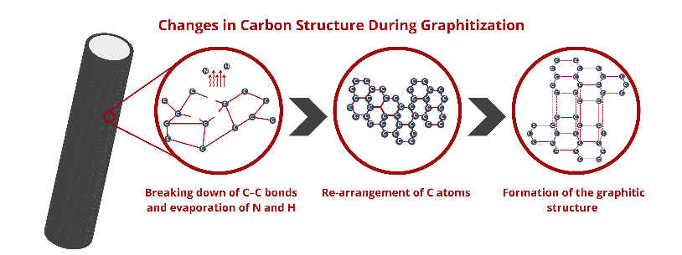



H
N
Membrane characteristic investigation
H
H
Molecular sieving
Adsorption diffusion
Component | % dipping solution
Bohemite | 0
Novolac 30 | 11
Formaldehyde | 2.4
Ethylenediamine | 0.4
Ni nitrate | 0.15
Kinetic diameter
Surface affinity with gases
N₂>H₂>NH₃
3.64>2.89>2.6 nm
T_{carb}=[550 - 700] °C
PARAMETERS INVESTIGATION
Carbonization temperature tuning
Functionalization of the polymer
Metal interacting with ammonia
(Ni, Zn, Co, Cu)
M⁺
IX Symposium on Hydrogen, Fuel cells and Advanced Batteries, June 30-July 03, 2024, Milazzo (Italy)
3

Slide 6
H
N
Experimental methods
H
H
Gas permeation tests
Pore size distribution
Laser microscope
IX Symposium on Hydrogen, Fuel cells and Advanced Batteries, June 30-July 03, 2024, Milazzo (Italy)
3

Slide 7
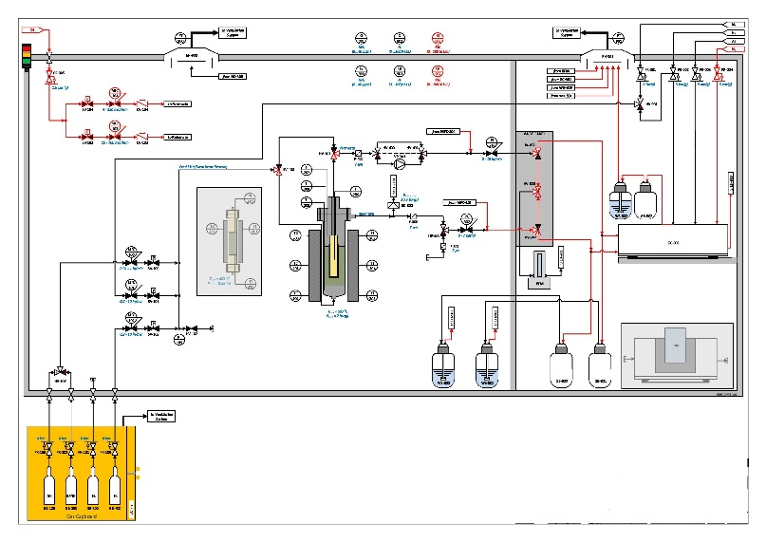
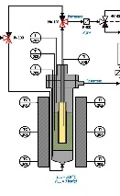
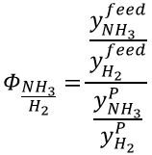



H
N
Experimental methods
H
H
Gas permeation tests
Pore size distribution
Laser microscope
Separation performance
Single gas test
Mixed gas test
$$℘_{i}=\frac{Q_{i}}{V_{m}∗A_{m}∗P∗(y_{i}^{R}−y_{i}^{P})}$$
$$Φ_{\frac{{NH}_{3}}{H_{2}}}=\frac{\frac{y_{{NH}_{3}}^{feed}}{y_{H_{2}}^{feed}}}{\frac{y_{{NH}_{3}}^{P}}{y_{H_{2}}^{P}}}$$
$$S_{\frac{{NH}_{3}}{H_{2}}}=\frac{℘_{{NH}_{3}}}{℘_{H_{2}}}$$
$$S_{\frac{H_{2}}{N_{2}}}=\frac{℘_{H_{2}}}{℘_{N_{2}}}$$
IX Symposium on Hydrogen, Fuel cells and Advanced Batteries, June 30-July 03, 2024, Milazzo (Italy)
3

Slide 8
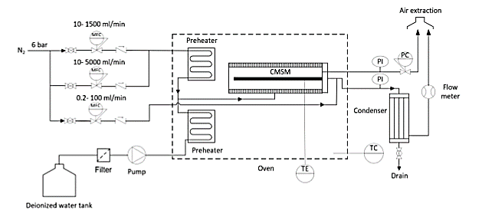



H
N
Experimental methods
H
H
Gas permeation tests
Pore size distribution
Laser microscope
$$r_{P}$$
*
Kelvin equation
$$RTln\left(\frac{P}{P_{S}}\right)=2υ\frac{σcosθ}{r_{P}}$$
- - - -
$$θ$$
*A. Rahimalimamaghani et al., ‘’ Effect of aluminium acetyl acetonate on the hydrogen and nitrogen permeation of carbon molecular sieves membranes’’, In.J of Hydrogen Energy (2022)
IX Symposium on Hydrogen, Fuel cells and Advanced Batteries, June 30-July 03, 2024, Milazzo (Italy)
3

Slide 9
H
N
Experimental methods
H
H
Gas permeation tests
Pore size distribution
Laser microscope
3D Laser Confocal Microscope
Quality of surface:
Surface roughness
Uniformity
Existence of cracks
Ra Ave. [µm] | Arithmetic average of profile height deviations from the mean line
Rz Ave. [µm] | Maximum peak to valley height of the profile
IX Symposium on Hydrogen, Fuel cells and Advanced Batteries, June 30-July 03, 2024, Milazzo (Italy)
3

Slide 10
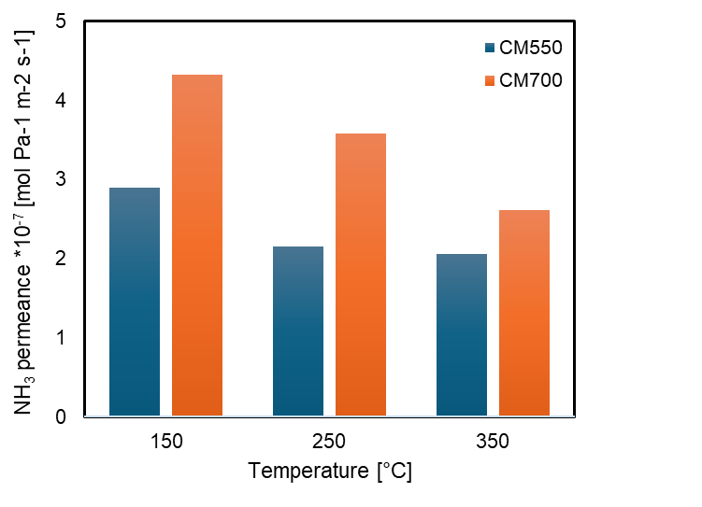
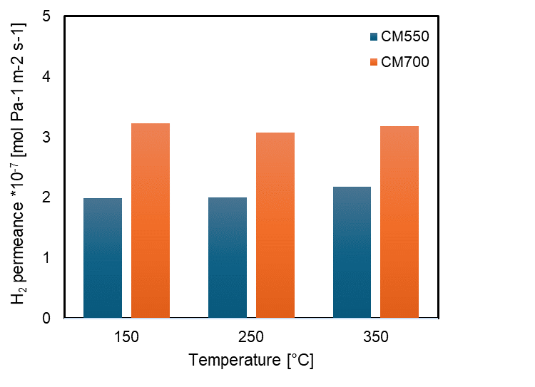
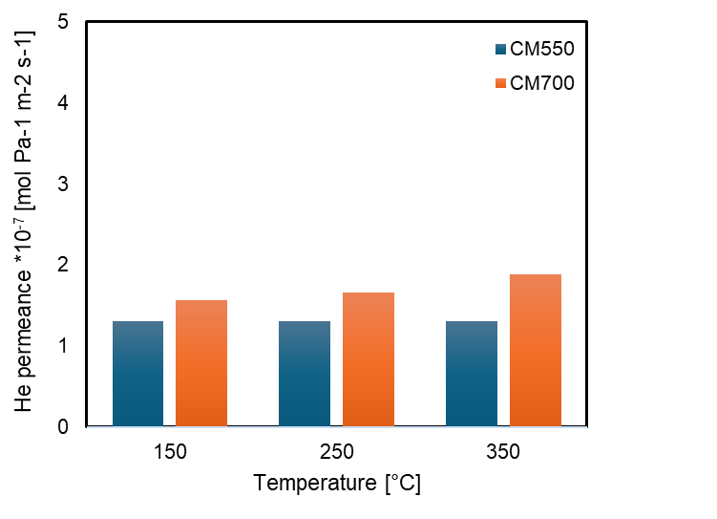




H
N
Results and discussion
H
H
Membrane performance separation with respect to T_{carb}
$$℘_{i}={\frac{∆P_{i}}{RT} D}_{i}^{0}exp\left[\frac{−\left(E_{act,i}−E_{ads,i}\right)}{RT}\right]$$
$$\left(E_{act,NH3}−E_{ads,NH3}\right)<0$$
$$\left(E_{act,H2}−E_{ads,H2}\right)<0$$
$$\left(E_{act,He}−E_{ads,He}\right)>0$$
AD dominant
AD dominant
MS dominant
IX Symposium on Hydrogen, Fuel cells and Advanced Batteries, June 30-July 03, 2024, Milazzo (Italy)
3

Slide 11
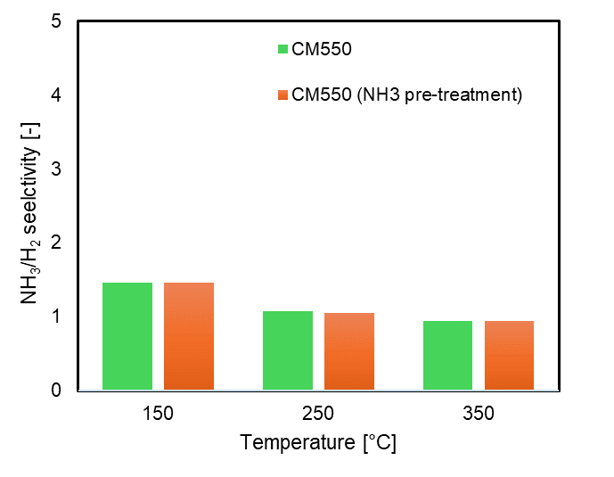
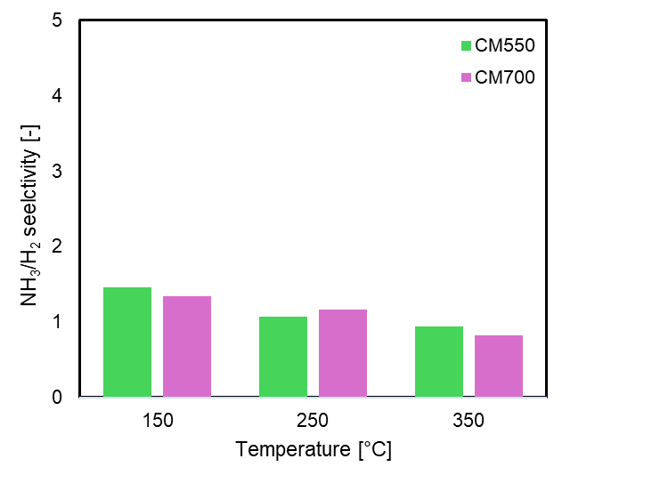
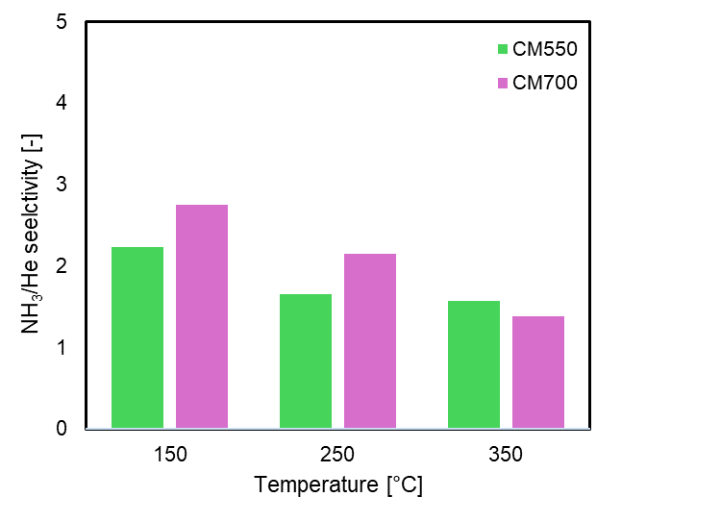

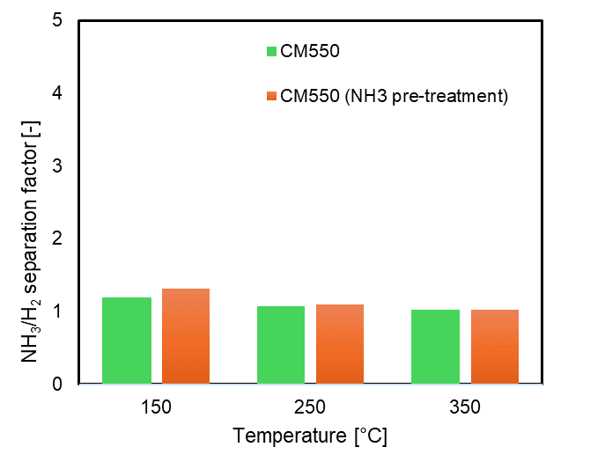
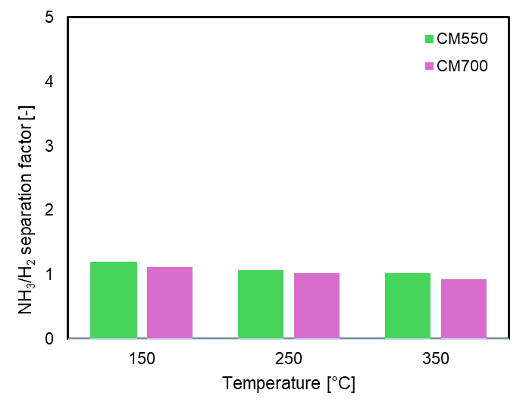
H
N
Results and discussion
H
H
Membrane performance separation with respect to T_{carb}
Single gas test
Pre-treatment with NH_{3,} to investigate interaction with active sites
Kinetic diameter
Mixed gas test
NH₃ ~ He < H₂
Mixed gas test
Interaction between pore walls and NH₃-H₂
IX Symposium on Hydrogen, Fuel cells and Advanced Batteries, June 30-July 03, 2024, Milazzo (Italy)
3

Slide 12
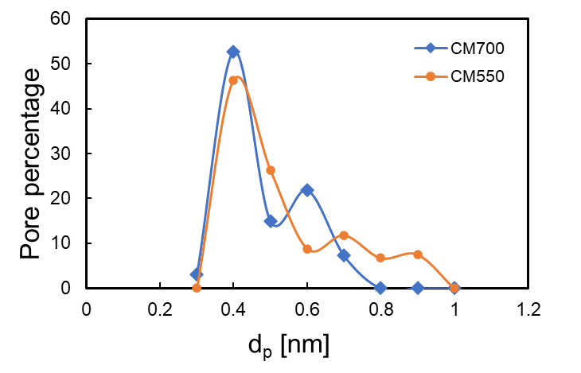
H
N
Results and discussion
H
H
Pore size distribution with respect to T_{carb}
pore size
CM550 > CM700
From gas permeation test CM700 results to be more selective than CM550
CM700 narrow pores with highest pore percentage at 0.4 and 0.6 nm
Limitation of the permporometry
Use of N₂ as inert gas for the analysis
IX Symposium on Hydrogen, Fuel cells and Advanced Batteries, June 30-July 03, 2024, Milazzo (Italy)
3

Slide 13
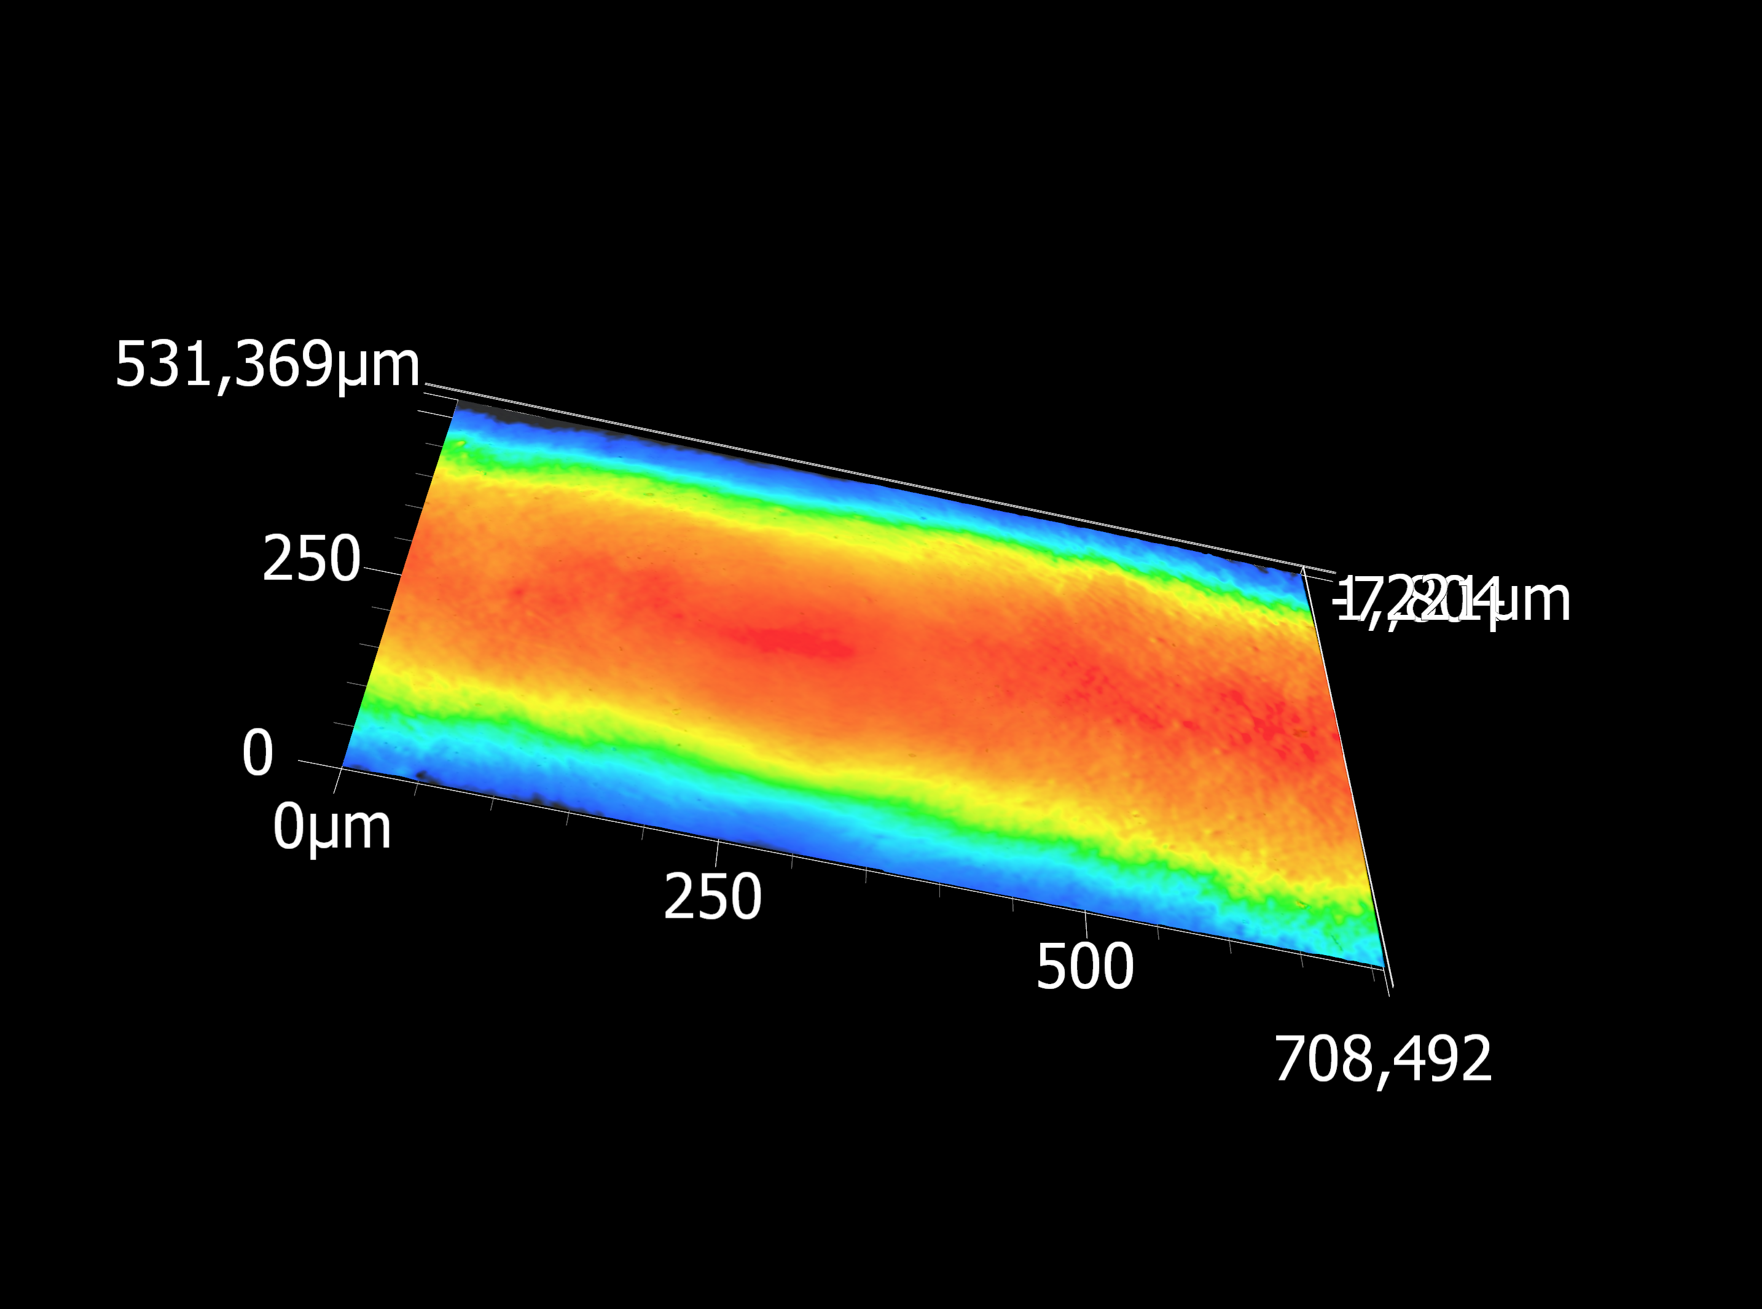
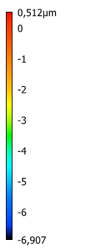
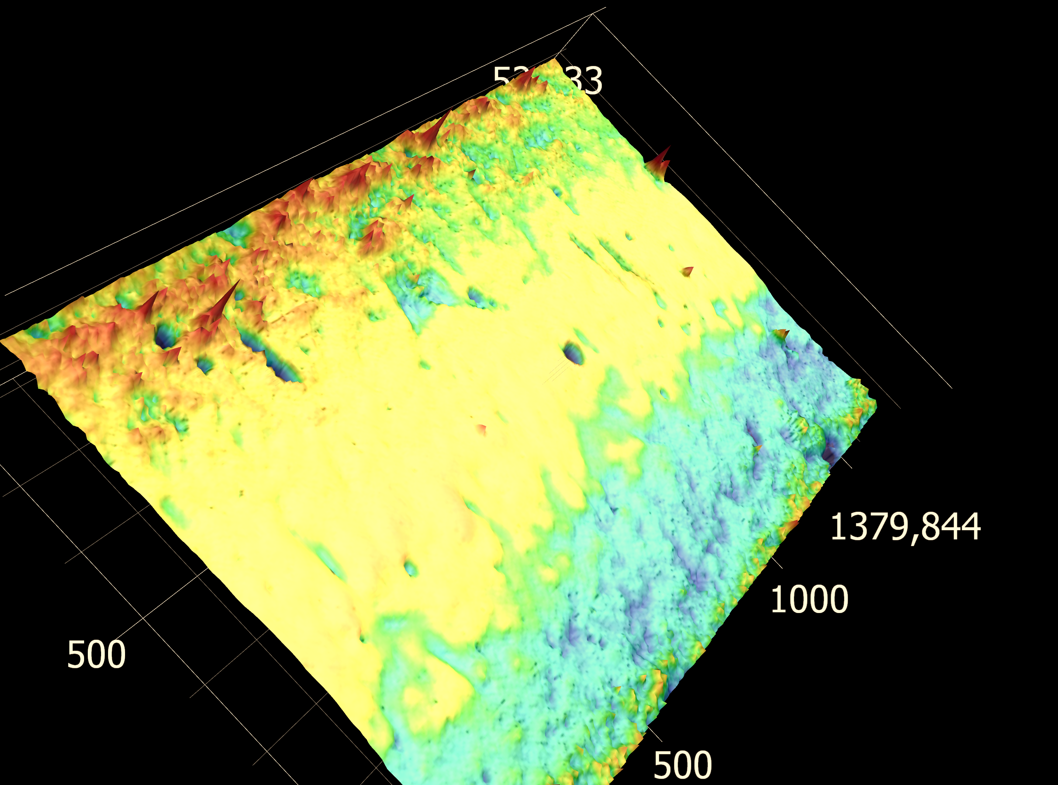
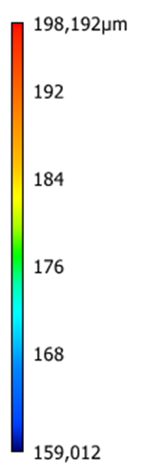
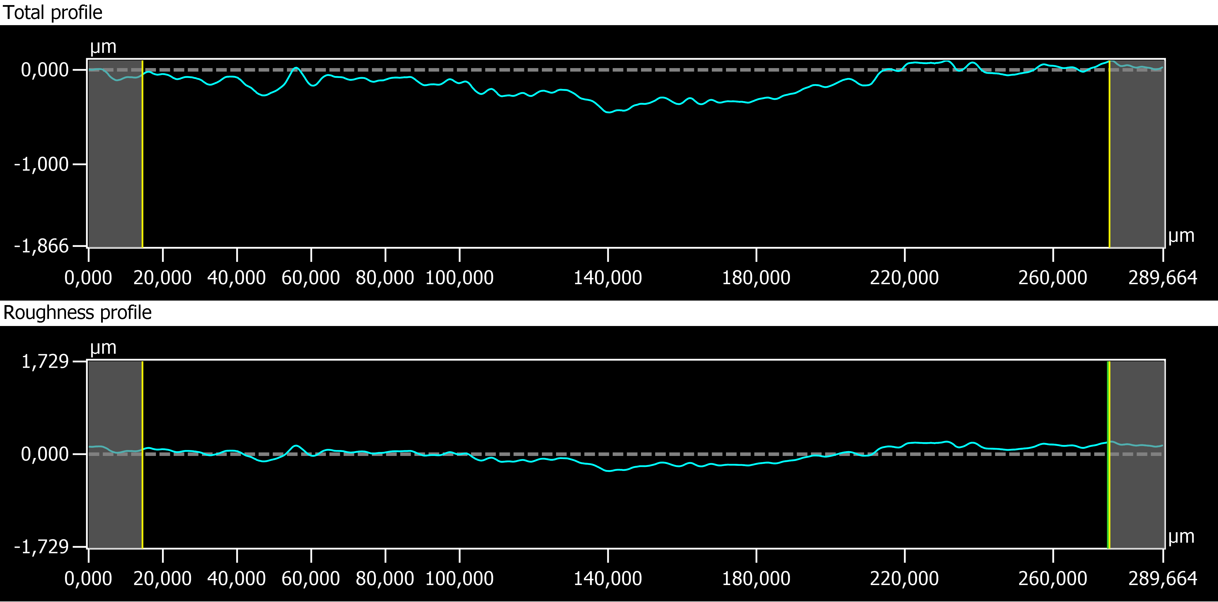
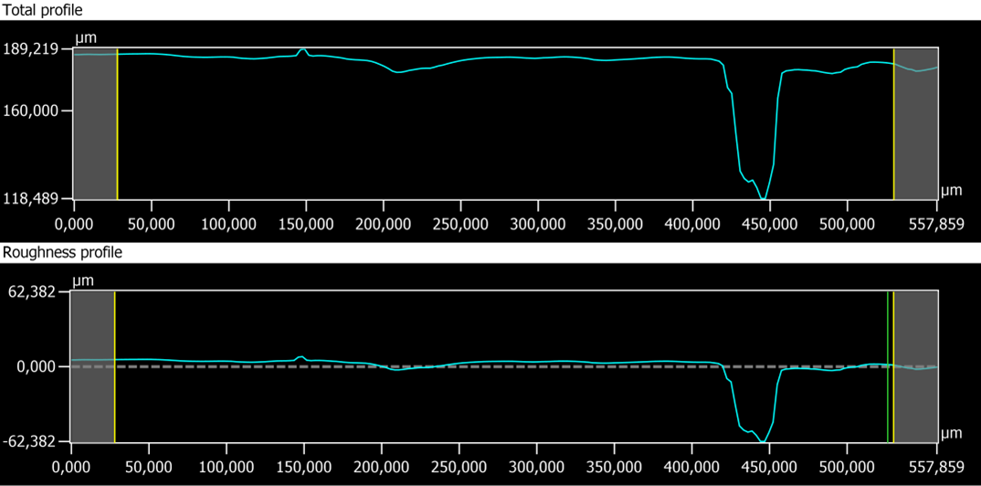
H
N
Results and discussion
H
Surface characterization with respect to T_{carb}
H
CM550
CM700
Ra [µm] | 0.119
Rz [µm] | 0.589
Ra [µm] | 6.405
Rz [µm] | 70.730
defects
IX Symposium on Hydrogen, Fuel cells and Advanced Batteries, June 30-July 03, 2024, Milazzo (Italy)
3

Slide 14
H
N
Conclusions
H
H
NH₃ and H₂ chemical interaction with membrane walls
Higher carbonization temperature leads to have higher NH₃ and H₂ permeance compared to He
Main transport mechanism for NH₃ is adsorption diffusion
Narrow pore size distribution for CM700 leads to have higher NH₃/H₂ and NH₃/He selectivities
IX Symposium on Hydrogen, Fuel cells and Advanced Batteries, June 30-July 03, 2024, Milazzo (Italy)
3

Slide 15

Thank you for the attention!
Questions??
This project has received funding from the European Union’s Horizon 2020 research and innovation programme under grant agreement No 101058565 (Ambher project).
Funded by the European Union. Views and opinions expressed are however those of the author(s) only and do not necessarily reflect those of the European Union. Neither the European Union nor the granting authority can be held responsible for them
IX Symposium on Hydrogen, Fuel cells and Advanced Batteries, June 30-July 03, 2024, Milazzo (Italy)

