Slide 1



Metal hydride nanocomposites as transition metal free catalysts for ammonia synthesis
Juliette Verschoor, MSc
Materials Chemistry and Catalysis, Debye Institute for Nanomaterials Science, Utrecht University.
18th International Symposium on Metal Hydride Systems, May 2024

Slide 2

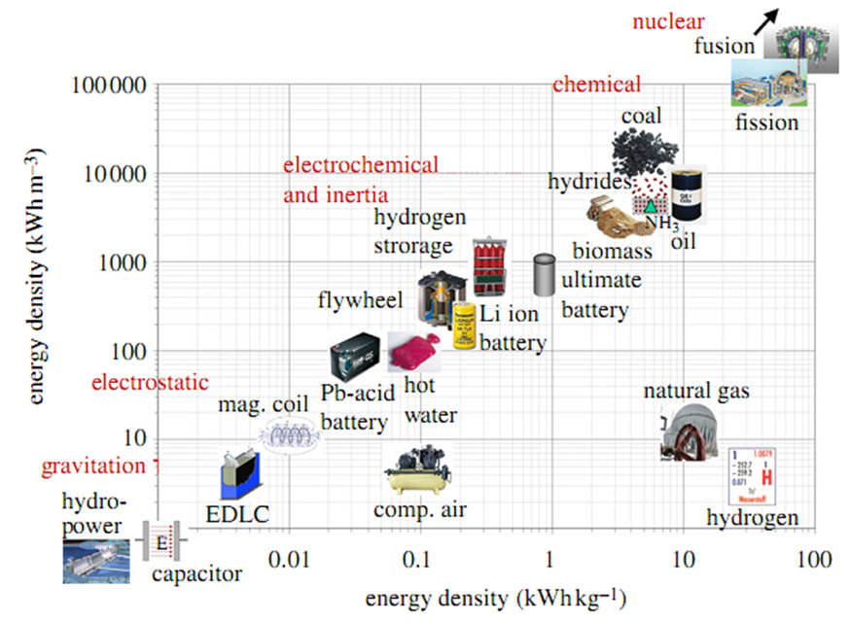
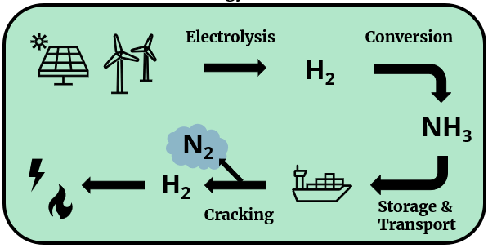
Ammonia as an energy carrier
High energy density (17.7 wt.% H)
Haber-Bosch process
Ease of storage
Provide H₂
NH₃
Volume based
Züttel et al., Phil. Trans. R. Soc. A, 2010, 368, 3329
Schüth et al., Energy Environ. Sci., 2012, 5, 6278
Weight based
Ammonia is increasingly recognized as a highly viable chemical energy carrier.

Slide 3
Ammonia synthesis
N₂ + 3H₂ 2NH₃ ∆H°= -92 kJ mol⁻¹ ∆S°= -198 J k⁻¹ mol⁻¹
For high ammonia yield: low temperature and high pressure
(from thermodynamics)
For fast ammonia formation: high temperature
(from kinetics)
Catalysts
Efficient ammonia production
Reaction at temperatures as low as possible

Slide 4
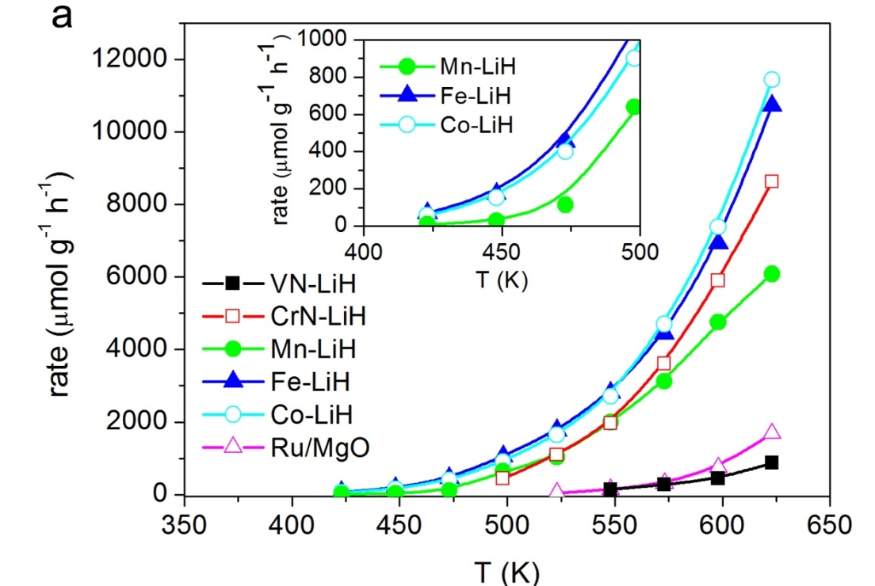
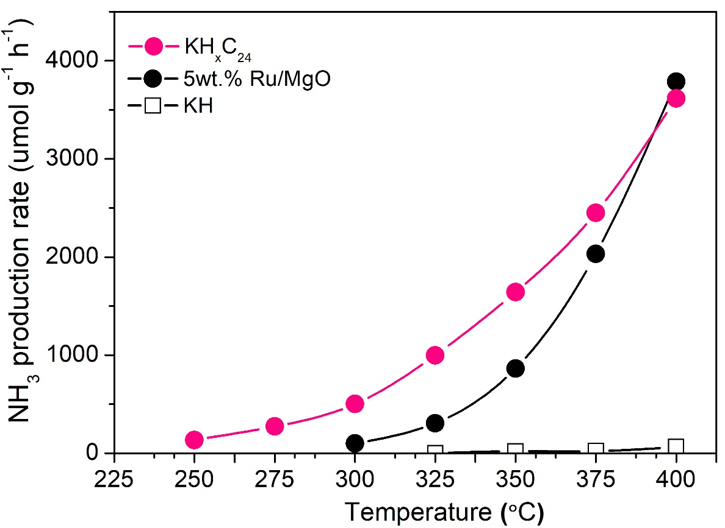
Alkali hydride mediated ammonia synthesis
3d TM+LiH composite catalysts achieved ammonia synthesis at a temperatures as low as 150°C
KHC nanocomposites catalysts achieved ammonia synthesis at temperatures as low as 250°C
NH₃ synthesis catalyzed by different catalysts under the conditions of 1 MPa, 1N₂:3H₂ and flow rate = 60,000 (left) – 36,000 (right) mL g_{cat}⁻¹ h⁻¹.
Wang, Peikun, et al. Nature chemistry 9.1 (2017): 64-70.
Chang, Fei, et al. Nature Catalysis 5.3 (2022): 222-230.

Slide 5
Alkali hydride mediated ammonia synthesis
Are other alkali metal (hydride) carbide nanocomposites also active for ammonia synthesis?
How does the synthesis method affect the activity?
Chang, Fei, et al. Nature Catalysis 5.3 (2022): 222-230.

Slide 6

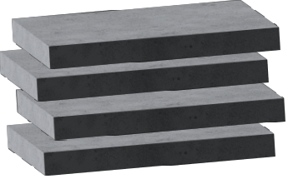
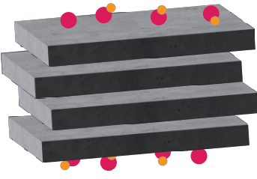
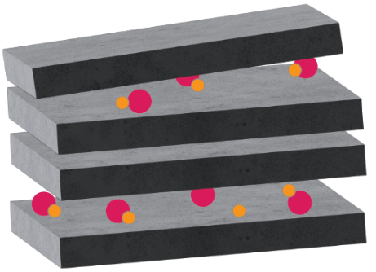
Alkali hydride carbide: melt infiltration
K⁺
Turbostratic graphite (C) +
Potassium hydride (KH)
H⁻
Melt infiltration
(200°C, Ar, 10h)
KH/C
Intercalation
(400°C, Ar, 2h)
KH_{x}C_{y}
Chang, Fei, et al. Nature Catalysis 5.3 (2022): 222-230.

Slide 7
AH-Carbon for ammonia synthesis
Besides KH, NaH & LiH based catalysts are also active towards ammonia synthesis
NH₃ synthesis catalyzed by different catalysts under the conditions of 1 MPa, 300-400 ℃, 1N₂-3H₂ and flow rate = 60,000 mL g_{cat}⁻¹ h⁻¹.

Slide 8
AH-Carbon for ammonia synthesis
Intercalation might not be required for ammonia synthesis activity.
NH₃ synthesis catalyzed by different catalysts under the conditions of 1 MPa, 300-400 ℃, 1N₂-3H₂ and flow rate = 60,000 mL g_{cat}⁻¹ h⁻¹.

Slide 9
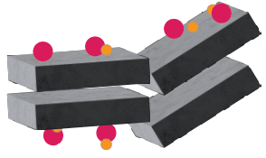
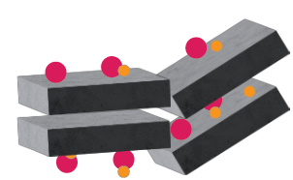
Alkali hydride carbide: ball milling
K⁺
Turbostratic graphite (C) +
Potassium hydride (KH)
H⁻
Ball Milling
500rpm, 6h, 20:1
KH/C
Heat treatment
(400°C, Ar, 2h)
KH_{x}C_{y}

Slide 10
KH-C: BM effect on 20wt%KH
BM can be used to synthesize KHC ammonia catalyst, but prone to destruction
NH₃ synthesis catalyzed by different catalysts under the conditions of 1 MPa, 300-400 ℃, 1N₂-3H₂ and flow rate = 60,000 mL g_{cat}⁻¹ h⁻¹.

Slide 11
NaH-C: BM effect on 10wt%NaH
BM can be used to synthesize NaH/C ammonia catalyst, less prone to destruction in contrast to KHC

Slide 12
AH-C: ball mill vs melt infiltration
NH₃ synthesis catalyzed by different catalysts under the conditions of 1 MPa, 300-400 ℃, 1N₂-3H₂ and flow rate = 60,000 mL g_{cat}⁻¹ h⁻¹.

Slide 13
Conclusion
In addition to KH, NaH and LiH based catalysts are also active towards ammonia synthesis.
Both ball milling and melt infiltration are suitable synthesis methods for the synthesis of alkali hydride-based ammonia catalysts from alkali hydrides and graphitic carbon materials.
Intercalation might not be required for ammonia synthesis activity.

Slide 14


Acknowledgement
Peter Ngene & Petra de Jongh
Jan Willem de Rijk
All of MCC
European Union – AMBHER consortium
Ammonia and MOF Based Hydrogen storagE for euRope
Thank you for you attention

