Slide 1
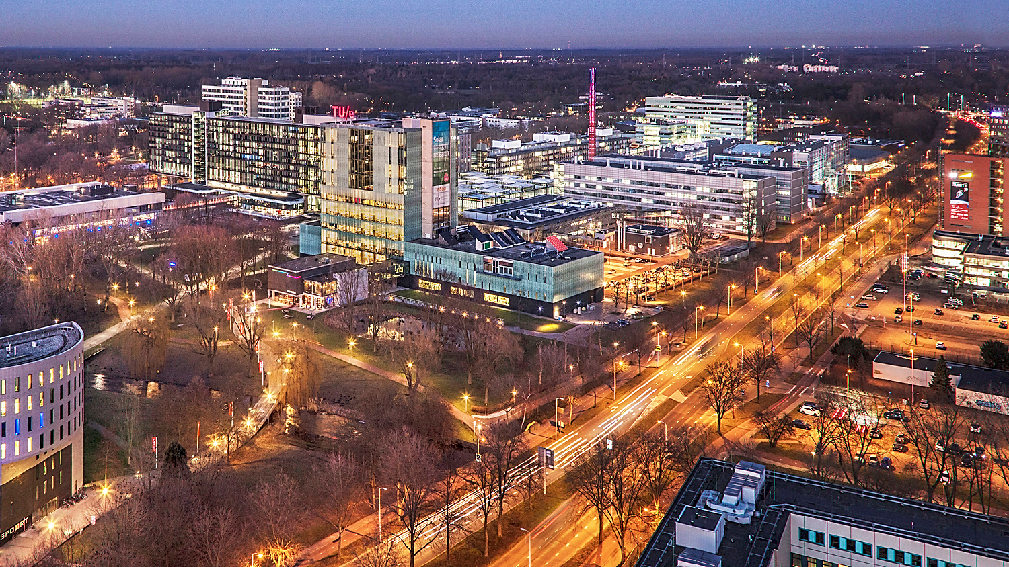
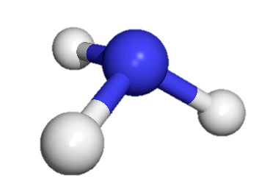



H
N
H
H
2D mathematical model study of a packed bed membrane reactor for ammonia synthesis: optimization, design and scale-up
I. Gargiulo, A.E. Simpelaar, E. A.J.F. Peters, F. Gallucci
Sustainable Process Engineering – Chemical Engineering and Chemistry – Eindhoven University of Technology
3rd SYMPOSIUM on AMMONIA ENERGY, Sep 23-26 2024, Shanghai (China)

Slide 2




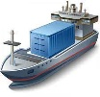
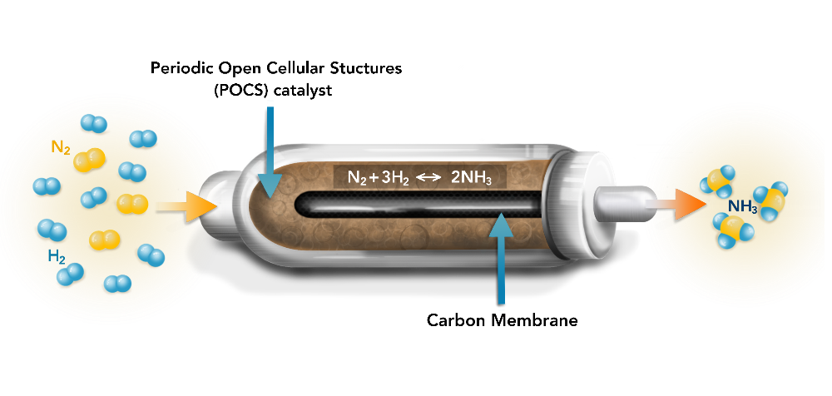
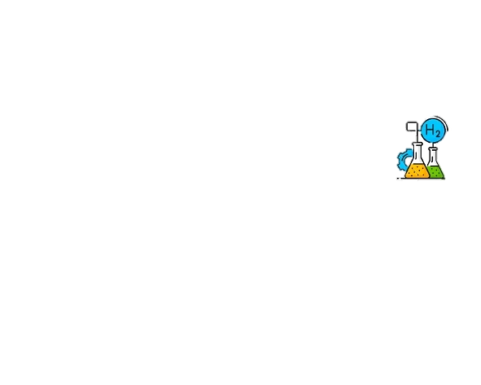
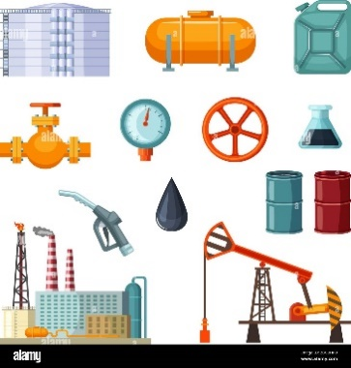
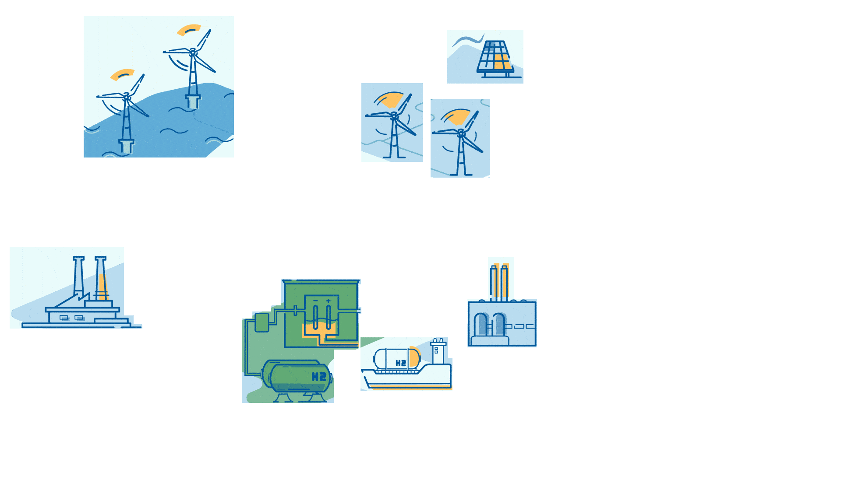
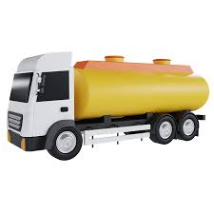
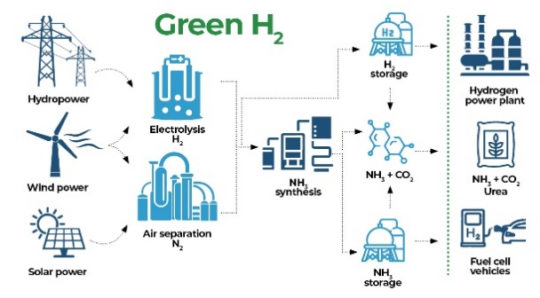
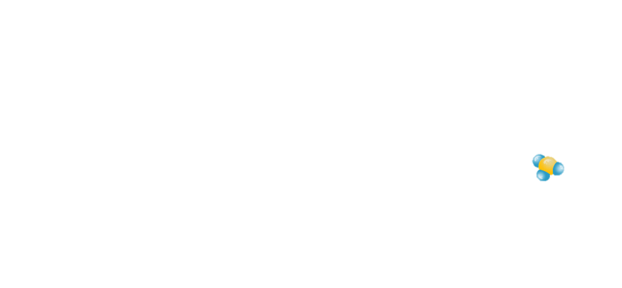
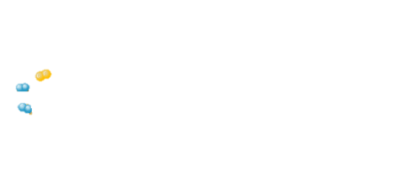


NH₃ in packed bed membrane reactor
Ammonia transport
and storage
Ammonia direct
utilization
Catalytic membrane reactor
for in-situ removal of NH₃
Shifting the equilibrium towards products
(Le Chatelier’s principle)
Renewable
energy
NH₃
Hydrogen
utilization
N₂
Ammonia
synthesis
H₂
Ammonia
decomposition
Effective heat management
Energy efficiency
Process intensification
Target conditions:
T=250-300 °C
P=20 bar
3rd SYMPOSIUM on AMMONIA ENERGY, Sep 23-26 2024, Shanghai (China)
2

Slide 3







Modeling approach
Assumption
Weisz-Prater criterion (C_{WP}): internal mass transfer
$$C_{WP}=\frac{r^{obs}ρ_{p}d_{p}^{2}}{D_{eff}C^{S}}≈{10}^{−3}$$
$C_{WP}≪1$
Neglected
Mears criterion (C_{M}):
external mass transfer
$$C_{M}=\frac{r^{obs}ρ_{p}d_{p}}{k_{gs}C^{bulk}}≈{10}^{−6}$$
$C_{M}≪0.15$
Neglected
Bodenstein number (Bo):
axial dispersion
$$Bo=\frac{uL}{D_{ax}}≈{10}^{3}$$
$C_{M}≫1$
Neglected
Reynold-Schmidt number (ReSc):
radial diffusion
$$\frac{r}{L}≪ReSc≪ \frac{L}{r}$$
Depending on the axial velocity, it cannot be always neglected
3rd SYMPOSIUM on AMMONIA ENERGY, Sep 23-26 2024, Shanghai (China)
3

Slide 4





Modeling approach
Model equations
$$\frac{∂c_{i}^{R}}{∂t}+div\left(c_{i}^{R}u^{R}−D_{i}·grad\left(c_{i}^{R}\right)\right)=r_{i}$$
Partial continuity equation: mass balance
$$\frac{∂c_{i}^{P}}{∂t}+div\left(c_{i}^{P}u^{P}−D_{i}·grad\left(c_{i}^{P}\right)\right)=0$$
$$\frac{∂T^{R}}{∂t}+u^{R}·grad\left(T^{R}\right)−α^{R}div\left(grad\left(T^{R}\right)\right)=\frac{rΔH_{r}}{ρ_{g}C_{{P,}_{g}}}$$
Partial continuity equation: energy balance
$$\frac{∂T^{P}}{∂t}+u^{P}·grad\left(T^{P}\right)−α^{P}div\left(grad\left(T^{P}\right)\right)=0$$
Ergun equation
$$\frac{∂P^{R}}{∂z}=−\left(\frac{150{ μ}_{mix }u^{R }{\left(1−ε\right)}^{2}}{ε^{3 }d_{p}^{2}}+\frac{1.75 \left(1−ε\right){ ρ}_{mix}{{ u}^{R}}^{2}}{ε^{3}{ d}_{p}}\right)$$
3rd SYMPOSIUM on AMMONIA ENERGY, Sep 23-26 2024, Shanghai (China)
4

Slide 5




Modeling approach
Boundary conditions
Partial continuity equation: mass balance
Inlet
$$z=0 0=0 (retentate)$$
$$z=0 0=0 (permeate)$$
$$r=R_{mo} D_{i}^{R}\frac{dc_{i}^{R}}{dr}=−J_{i}$$
Membrane wall
$$r=R_{mi} D_{i}^{P}\frac{dc_{i}^{P}}{dr}=J_{i}\frac{R_{mo}}{R_{mi}}$$
$$r=R_{R} \frac{dc_{i}^{R}}{dr}=0$$
Reactor wall
$$r=0 \frac{dc_{i}^{P}}{dr}=0$$
Centre
3rd SYMPOSIUM on AMMONIA ENERGY, Sep 23-26 2024, Shanghai (China)
5

Slide 6




Modeling approach
Boundary conditions
Partial continuity equation: energy balance
Inlet
$$z=0 0=0 (retentate)$$
$$z=0 0=0 (permeate)$$
Membrane wall
$r=R_{mo} λ^{R}\frac{dT^{R}}{dr}=−U(T^{R}−$ $T^{P})\frac{R_{mo}}{R_{mi}}$
$r=R_{mi} λ^{P}\frac{dT^{P}}{dr}=U(T^{R}−$ $T^{P})$
$$r=R_{R} \frac{dT^{R}}{dr}=0$$
Reactor wall
$$r=0 \frac{dT^{P}}{dr}=0$$
Centre
3rd SYMPOSIUM on AMMONIA ENERGY, Sep 23-26 2024, Shanghai (China)
6

Slide 7
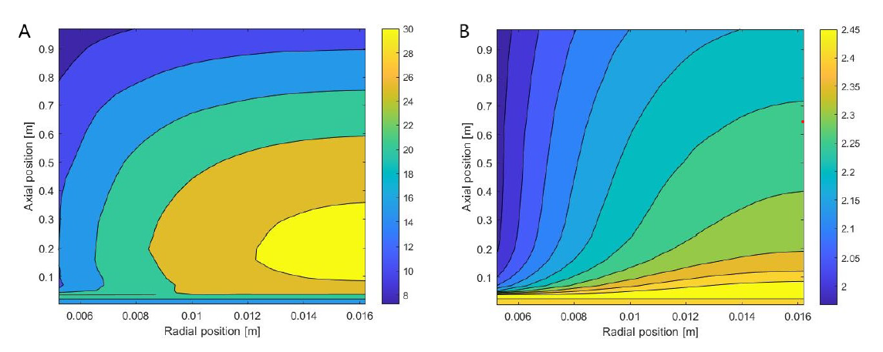
Deviation between 1D and 2D model
Concentration profile in two different case scenario when $\frac{r}{L}≪ReSc≪ \frac{L}{r}$ is still valid
P^{R}=30 bar , GHSV= 21 1/h
P^{R}=5 bar , GHSV= 126 1/h
When using high P, even at low GHSV, there is a bigger concentration gradients, due to the diffusion limitation
3rd SYMPOSIUM on AMMONIA ENERGY, Sep 23-26 2024, Shanghai (China)
7

Slide 8
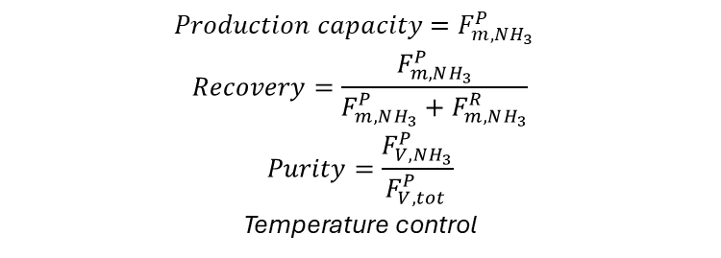
Optimization of 2D model
Performance factor
$$Production capacity=F_{m,NH_{3}}^{P}$$
$$Recovery=\frac{F_{m,NH_{3}}^{P}}{F_{m,NH_{3}}^{P}+F_{m,NH_{3}}^{R}}$$
$$Purity=\frac{F_{V,NH_{3}}^{P}}{F_{V,tot }^{P}}$$
Temperature control
3rd SYMPOSIUM on AMMONIA ENERGY, Sep 23-26 2024, Shanghai (China)
8

Slide 9
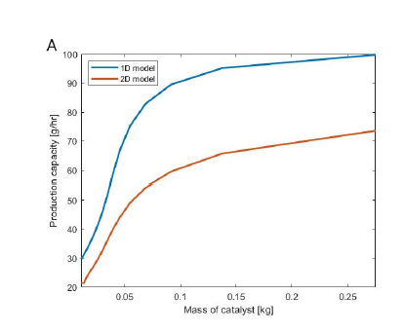
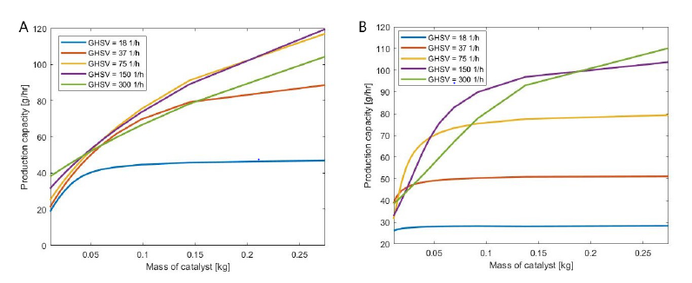
Optimization of 2D model
Catalyst weight study according to GHSV
Isothermal
Non-Isothermal
3rd SYMPOSIUM on AMMONIA ENERGY, Sep 23-26 2024, Shanghai (China)
9

Slide 10
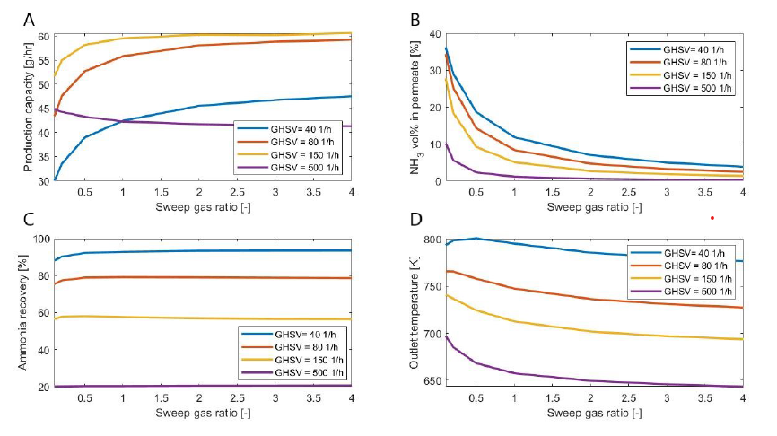
Optimization of 2D model
  Sweep gas ratio study according to GHSV
3rd SYMPOSIUM on AMMONIA ENERGY, Sep 23-26 2024, Shanghai (China)
10

Slide 11
Optimization of 2D model
  What about SW composition?
When there is only N2, outlet temperature is lower, due to the higher heat capacity
Important to keep the temperature profile constant and low, for the membrane selectivity
3rd SYMPOSIUM on AMMONIA ENERGY, Sep 23-26 2024, Shanghai (China)
11

Slide 12
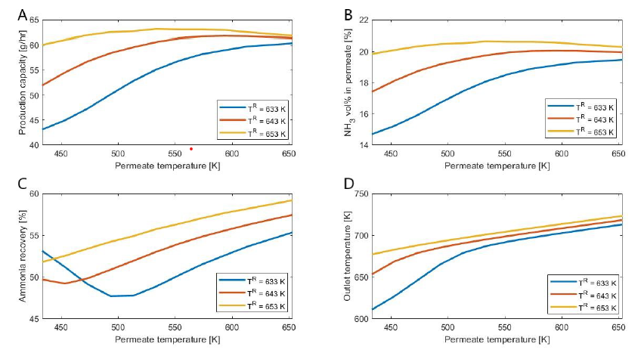
Optimization of 2D model
  Retentate and permeate temperature study
3rd SYMPOSIUM on AMMONIA ENERGY, Sep 23-26 2024, Shanghai (China)
12

Slide 13
Optimization of 2D model
  Optimized reactor conditions
3rd SYMPOSIUM on AMMONIA ENERGY, Sep 23-26 2024, Shanghai (China)
13

Slide 14
Design and scale-up
  Length influence study
 | L_{mem} (m) | D_{R} (m)
Geometry 1 | 0.2 | 0.05133
Geometry 2 | 0.95 | 0.05133
Geometry 1(X5) | 1.0 | 0.05133
Geometry 1 (X6) | 1.2 | 0.05133
Membrane
Reactor
3rd SYMPOSIUM on AMMONIA ENERGY, Sep 23-26 2024, Shanghai (China)
14

Slide 15
Design and scale-up
  Length influence study
 | Total membrane length [m] | Production capacity [g/hr] | Purity [%] | Catalyst weight [g]
Geometry 1 | 0.95 | 68.4 | 45.3 | 235
Geometry 2 | 0.2 | 12.5 | 34.3 | 35
Geometry 2 (X5) | 1.0 | 62.5 | 34.3 | 175
Geometry 2 (X6) | 1.2 | 75 | 34.3 | 210
Catalyst mass in geometry 2 with 6 short reactors is lower than one single membrane reactor with geometry 1
At the same time the production capacity is higher
3rd SYMPOSIUM on AMMONIA ENERGY, Sep 23-26 2024, Shanghai (China)
15

Slide 16
Design and scale-up
  Diameter influence study
At 1 cm production capacity is already 45 g/hr, and with a four-time distance this is increased about 62%.
At the same time more catalyst is needed
3rd SYMPOSIUM on AMMONIA ENERGY, Sep 23-26 2024, Shanghai (China)
16

Slide 17
Design and scale-up
  Cooling strategy: reaction profiles
No wall cooling
T_{W}=T_{IN}=653 K
T_{W}=T_{AVE}=683 K
Fast reaction at the membrane wall, very slow at reactor wall
Reaction slow everywhere
Faster reaction at the bottom because the gas is heated by the wall
Using lower Temperature would decrease too much the reaction rate
3rd SYMPOSIUM on AMMONIA ENERGY, Sep 23-26 2024, Shanghai (China)
17

Slide 18
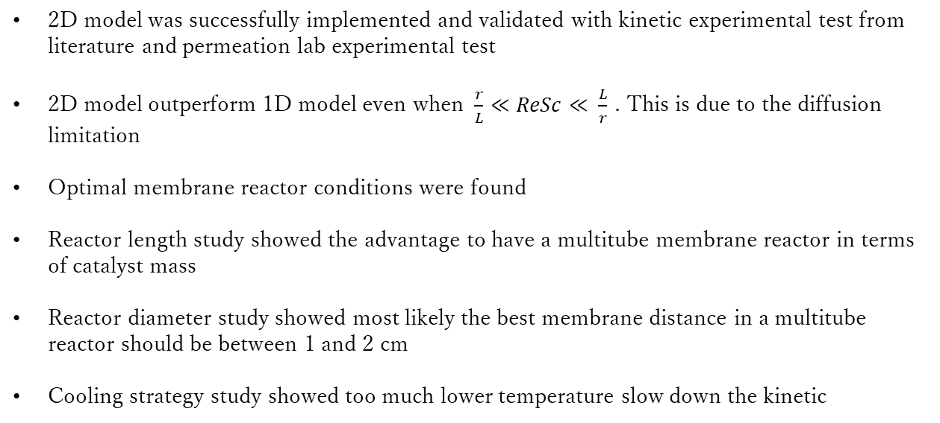
Conclusions
2D model was successfully implemented and validated with kinetic experimental test from literature and permeation lab experimental test
2D model outperform 1D model even when $\frac{r}{L}≪ReSc≪ \frac{L}{r}$ . This is due to the diffusion limitation
Optimal membrane reactor conditions were found
Reactor length study showed the advantage to have a multitube membrane reactor in terms of catalyst mass
Reactor diameter study showed most likely the best membrane distance in a multitube reactor should be between 1 and 2 cm
Cooling strategy study showed too much lower temperature slow down the kinetic
3rd SYMPOSIUM on AMMONIA ENERGY, Sep 23-26 2024, Shanghai (China)
18

Slide 19
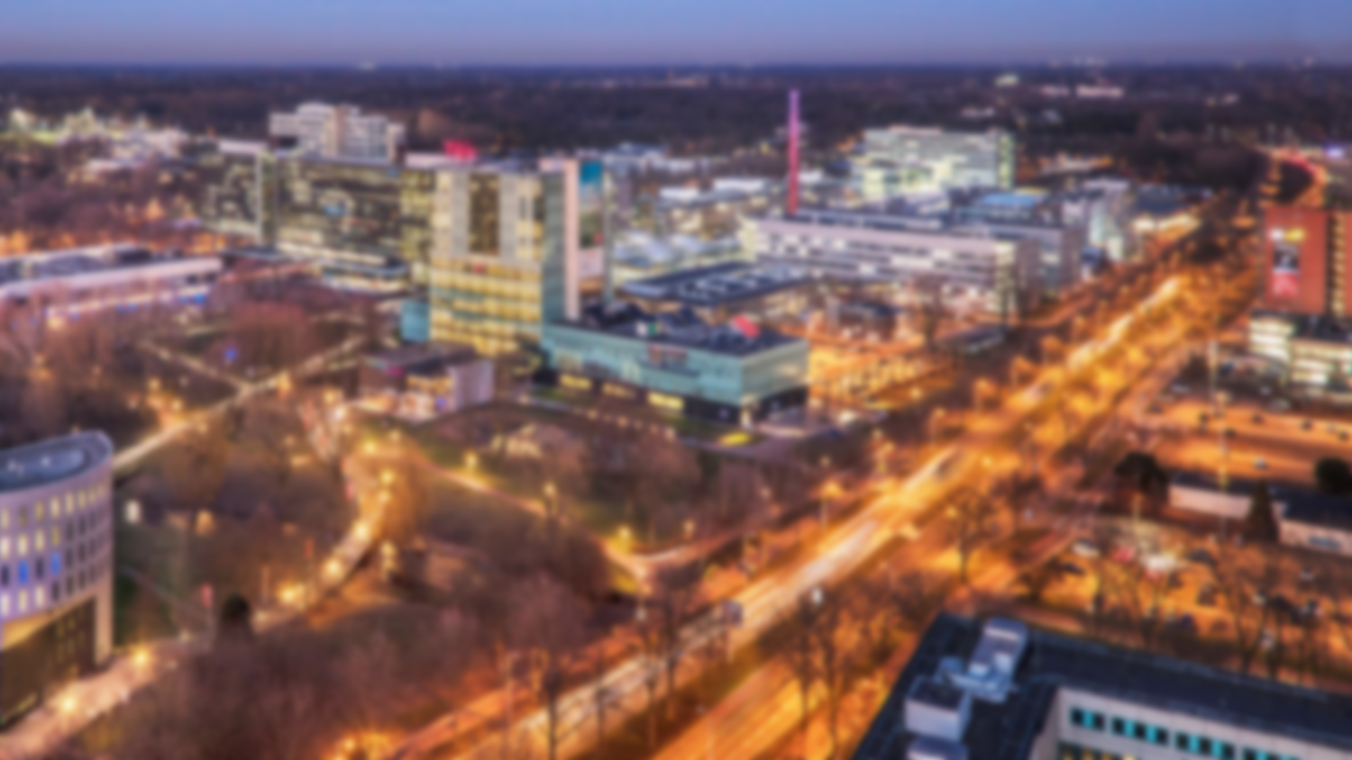
Thank you for the attention!
Questions??
This project has received funding from the European Union’s Horizon 2020 research and innovation programme under grant agreement No 101058565 (Ambher project).
Funded by the European Union. Views and opinions expressed are however those of the author(s) only and do not necessarily reflect those of the European Union. Neither the European Union nor the granting authority can be held responsible for them
3rd SYMPOSIUM on AMMONIA ENERGY, Sep 23-26 2024, Shanghai (China)

